Slide 1




INTERNSHIP
FINAL EXERCISE
Notes:
1

Slide 2



MUSIC MANAGER APP
Notes:
2

Slide 3
Requirements scope
Functional and system scope
1
Technology
Technologies used
Folder structure organization
2
Key deliverables
Key features of app
API structure overview
CONTENT
3
Demo
APP UI overview
4
Lessons
Technical lessons
Soft skill lessons
5
3

Slide 4
1. Requirements scope
4
Notes:
2

Slide 5

01
Song management
View, search, paginate, add, edit, delete
02
Playlist management
Create playlists, add songs to playlists
1. Requirements scope
Music player
Play/pause, play from list, next/previous, play repeat/shuffle, volume control
03
04
Wishlist management
Add songs to wishlist
5

Slide 6
2. Technology
6
Notes:
2

Slide 7
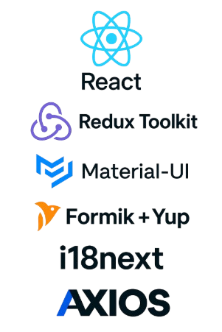
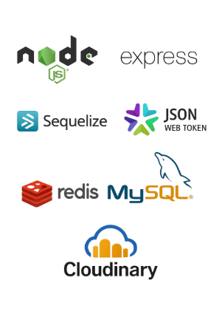
2.1. Tech stack
Picture 1: Frontend
Picture 2: Backend
7

Slide 8


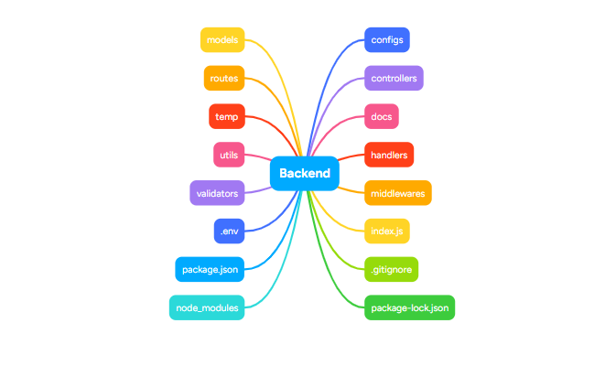
2.2. Folder structure
Picture 3: Backend folder
8
Notes:
3

Slide 9
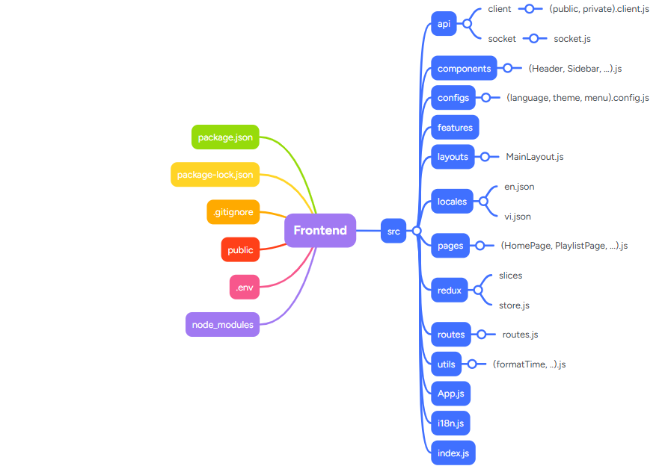
2.2. Folder structure
Picture 4: Frontend folder
9
Notes:
3

Slide 10
3. Key deliverables
10
Notes:
2

Slide 11
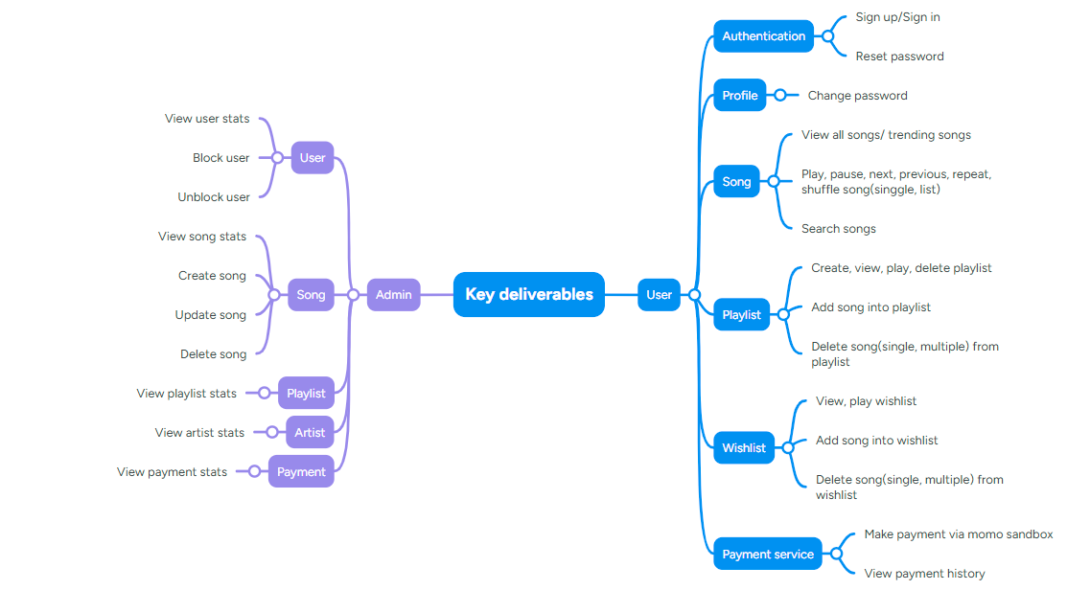
3.1. Key deliverables
Picture 5: Key deliverables
11
Notes:
3

Slide 12
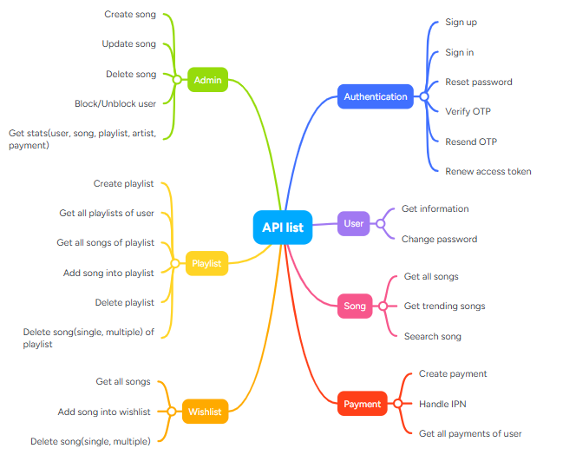
3.2. API structure
Picture 6: API structure
12
Notes:
3

Slide 13
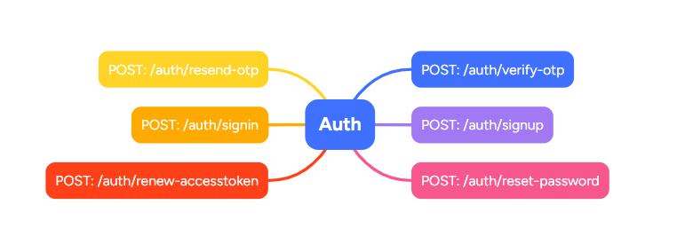
3.2. API structure
Picture 7: Auth API
13
Notes:
3

Slide 14
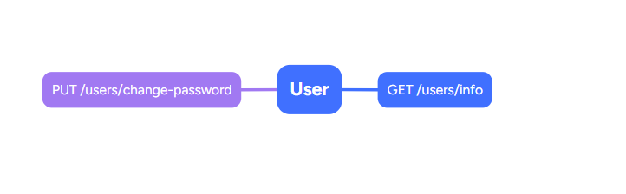
3.2. API structure
Picture 8: User API
14
Notes:
3

Slide 15
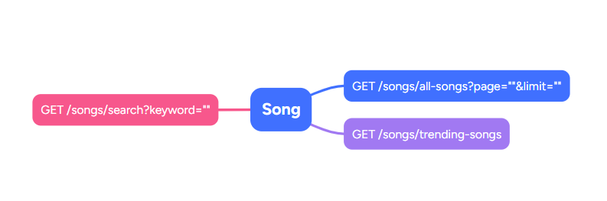
3.2. API structure
Picture 9: Song API
15
Notes:
3

Slide 16
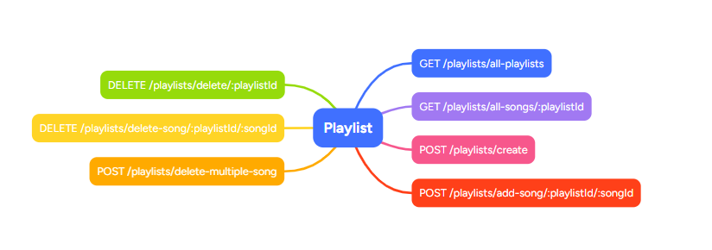
3.2. API structure
Picture 10: Playlist API
16
Notes:
3

Slide 17
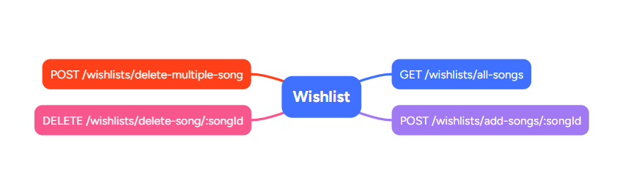
3.2. API structure
Picture 11: Wishlist API
17
Notes:
3

Slide 18
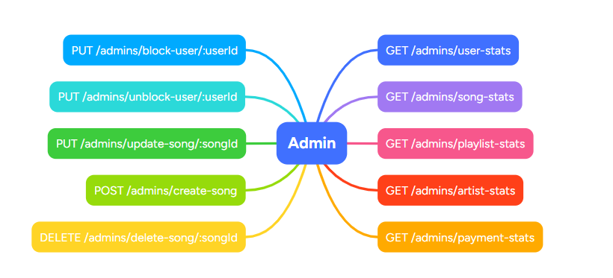
3.2. API structure
Picture 12: Admin API
18
Notes:
3

Slide 19
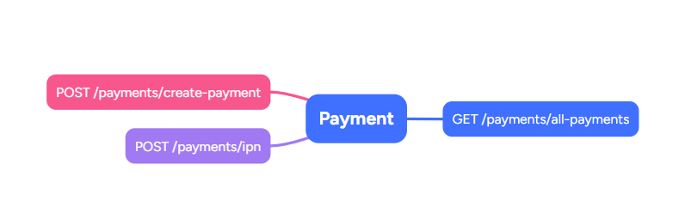
3.2. API structure
Picture 13: Payment API
19
Notes:
3

Slide 20
4. Demo
20
Notes:
2

Slide 21
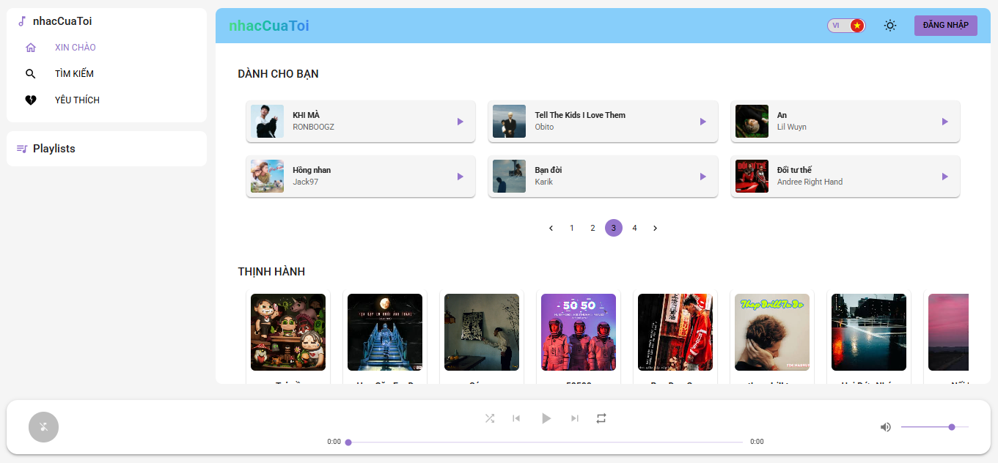
4. Demo
Picture 14: Home page(light mode)
21
Notes:
3

Slide 22
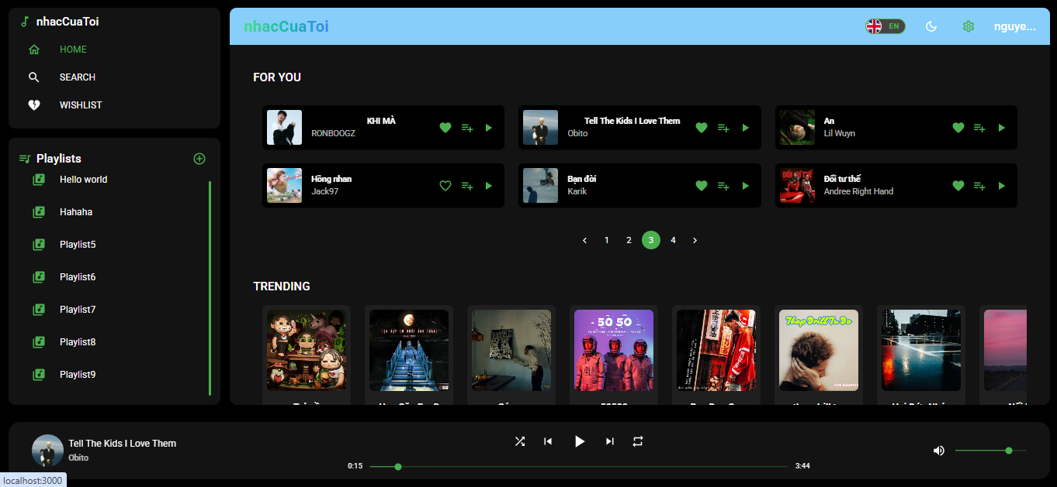
4. Demo
Picture 15: Home page(dark mode)
22
Notes:
3

Slide 23
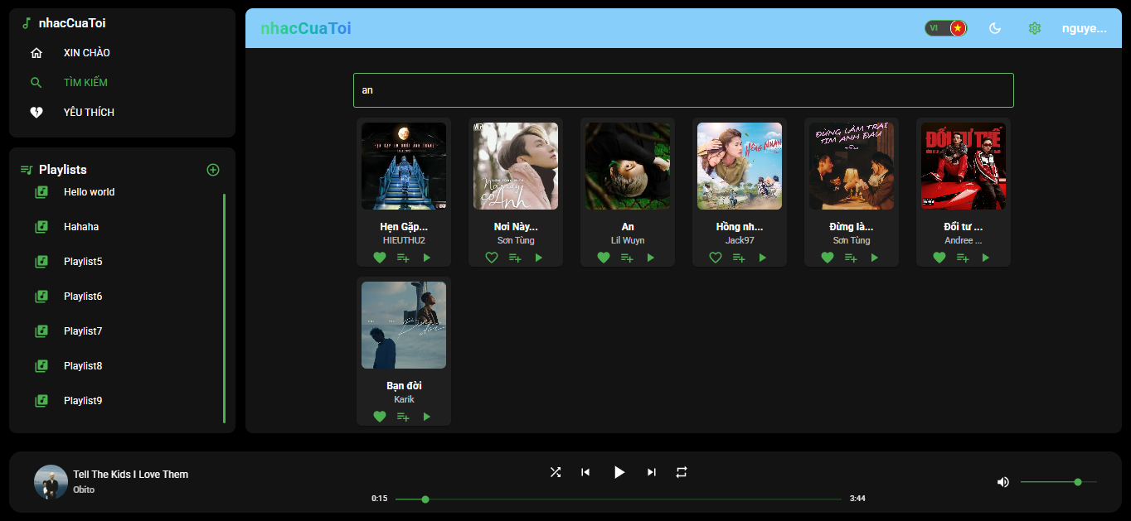
4. Demo
Picture 16: Search page(dark mode)
23
Notes:
3

Slide 24
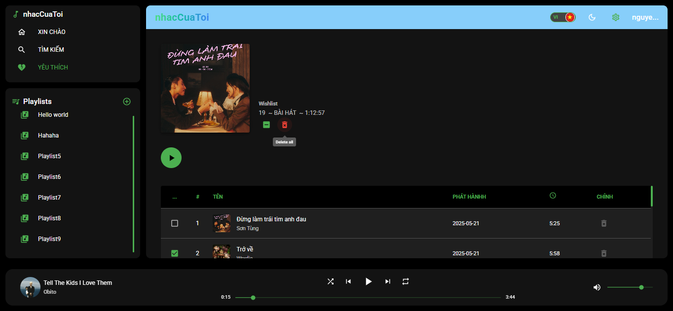
4. Demo
Picture 17: Wishlist page(dark mode)
24
Notes:
3

Slide 25
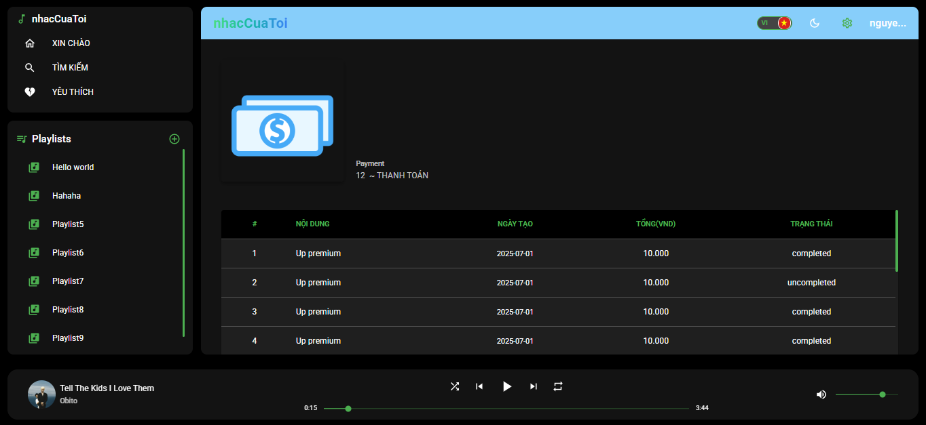
4. Demo
Picture 18: Payment history page(dark mode)
25
Notes:
3

Slide 26
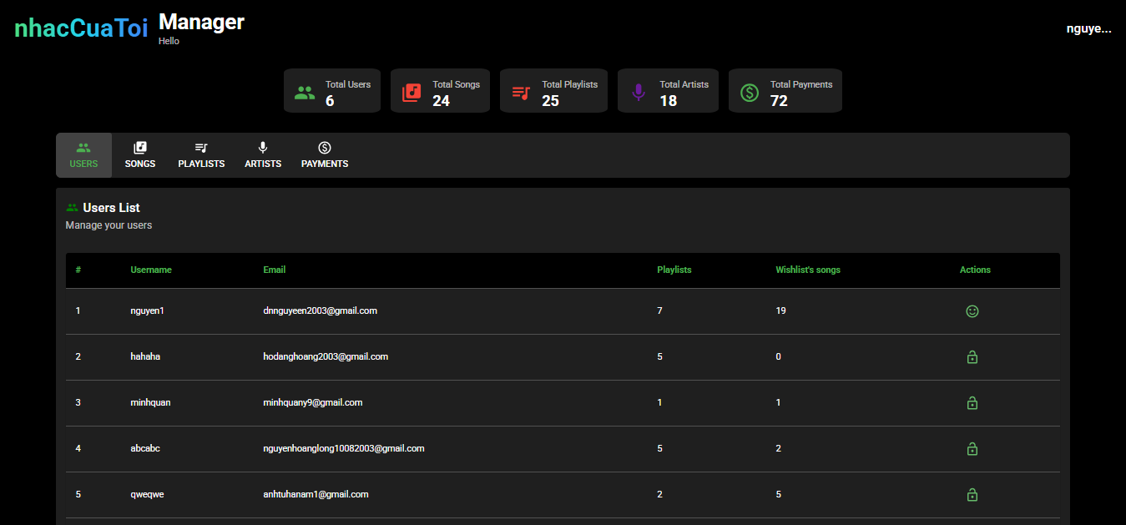
4. Demo
Picture 19: Admin page(dark mode)
26
Notes:
3

Slide 27
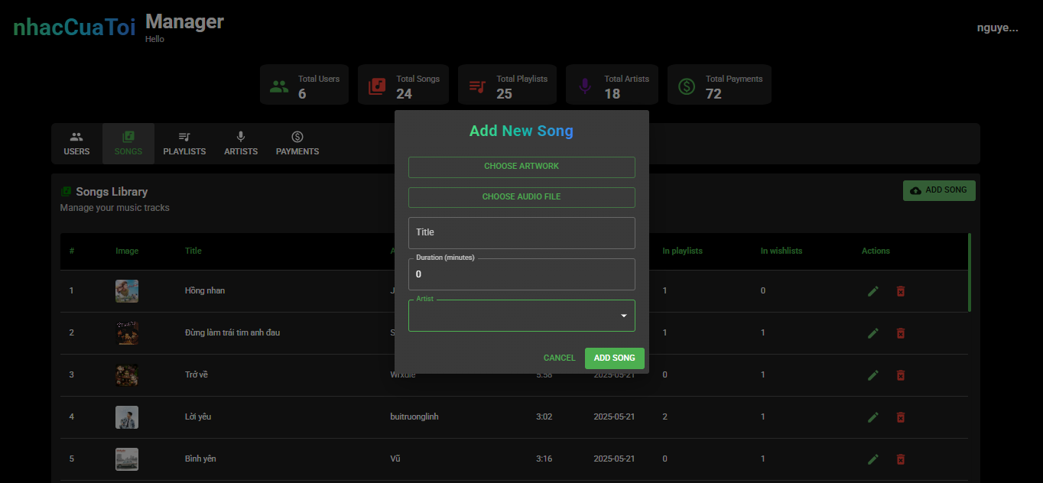
4. Demo
Picture 20: Create song dialog(dark mode)
27
Notes:
3

Slide 28
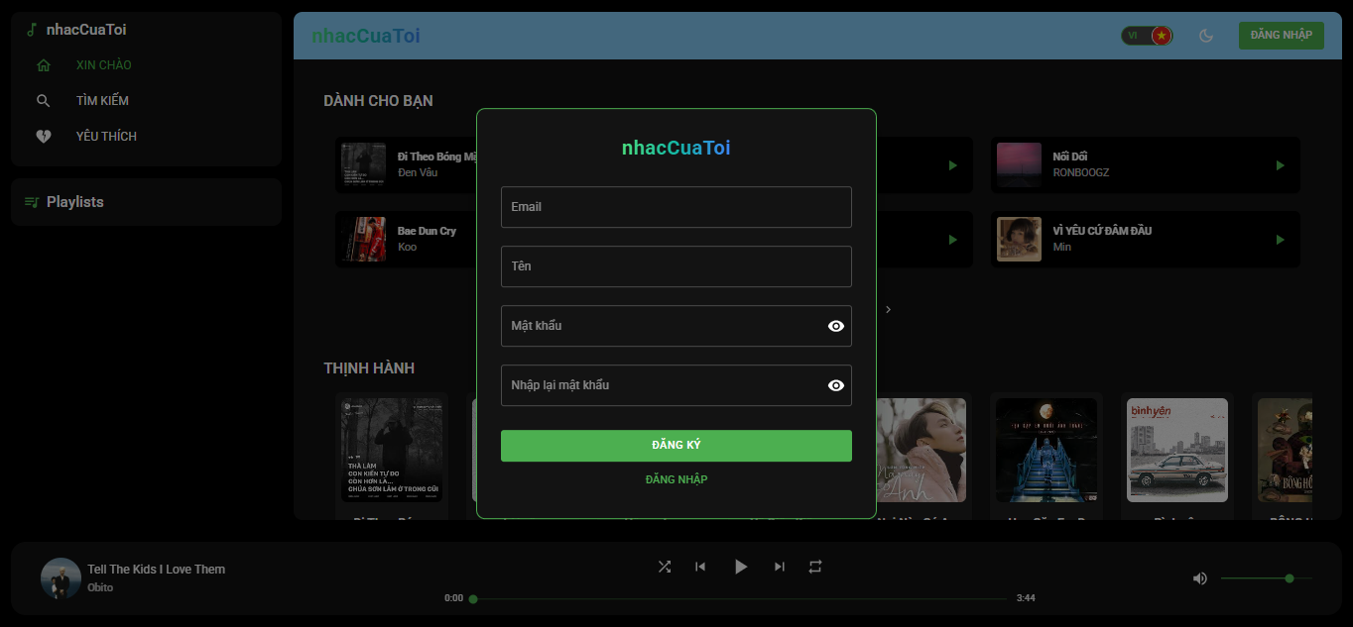
4. Demo
Picture 21: Sign up modal(dark mode)
28
Notes:
3

Slide 29
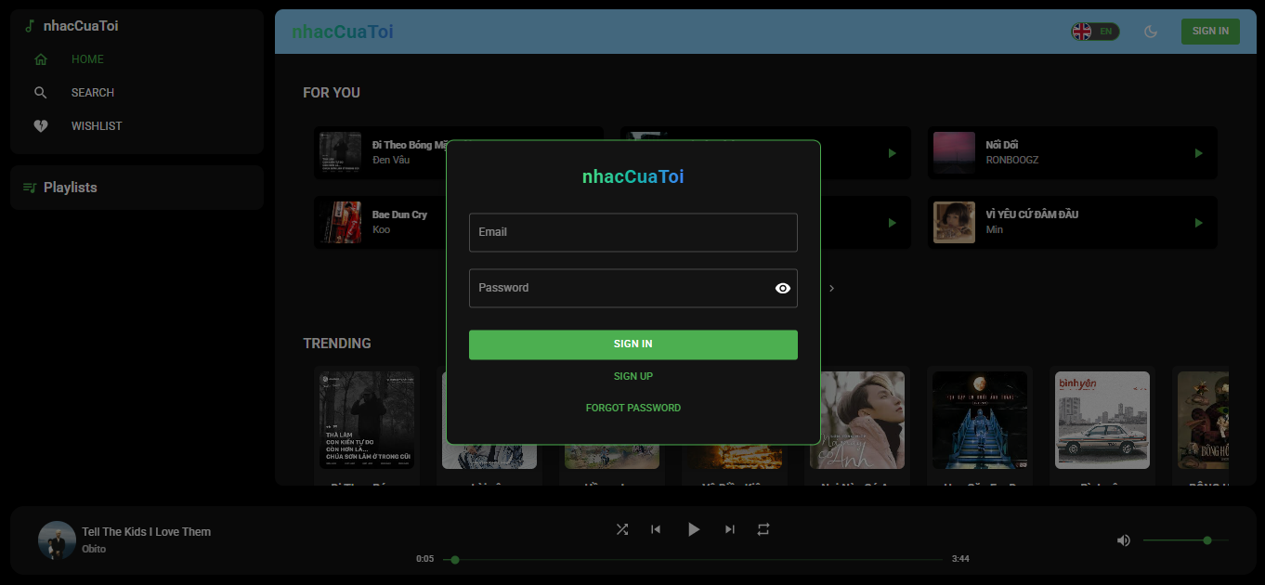
4. Demo
Picture 22: Sign in modal(dark mode)
29
Notes:
3

Slide 30
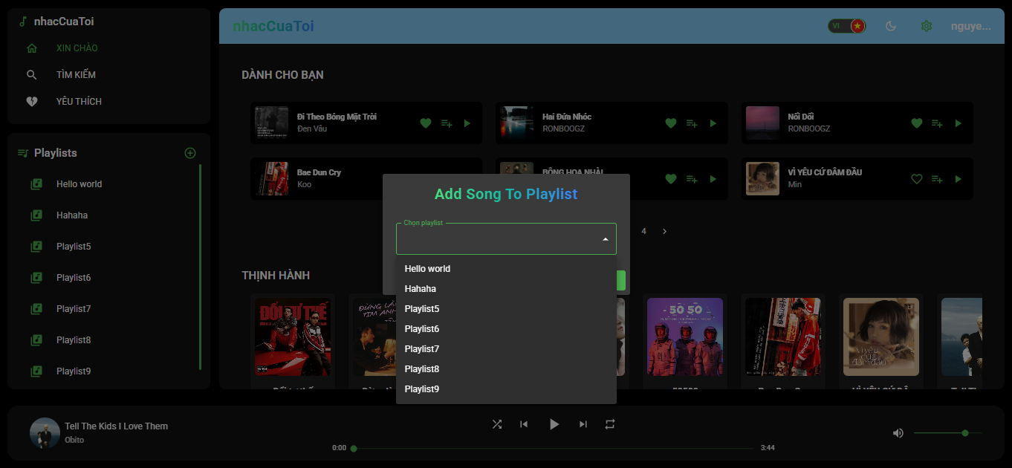
4. Demo
Picture 23: Add song to playlist dialog(dark mode)
30
Notes:
3

Slide 31
5. Lessons
31
Notes:
2

Slide 32
01
Development workflow
Understand the development process of application
02
React & Redux practices
Manage state effectively, avoid overusing the global store
5.1. Technical lessons
API Design
Design RESTful APIs with clear separation of routes, controllers, and services
03
04
API Integration
Handle API calls properly, manage loading, error, and empty states
32

Slide 33
01
Communication
Communicate clearly, proactively ask questions
02
Email writing
Write proper and concise emails
5.2. Soft skill lessons
Work etiquette
Be punctual, respect deadlines, and follow company rules
03
04
Teamwork
Collaborate effectively, support team members, share knowledge
33

Slide 34
THANK YOU!
Vietnam:
North America:
Europe:
+84 28 3997 8000
+1 844 224 4188
+49 171 617 3356
Australia:
Japan:
+61 478 407 408
+81 364 324 994
Email:
sales@tmasolutions.com
Website:
www.tmasolutions.com

